Slide 1
Office of Student Academic Affairs
MISSION – acting on behalf of the BCOE and its departments, the advising office supports engineering students in achieving their full academic potential by providing guidance and services which enhance students academic development.
The first line of contact regarding
academic concerns and opportunities!!!
REFER STUDENTS TO BCOE OFFICE OF STUDENT ACADEMIC AFFAIRS ON ALL ACADEMIC AND ENROLLMENT CONCERNS!!!!!

Slide 2
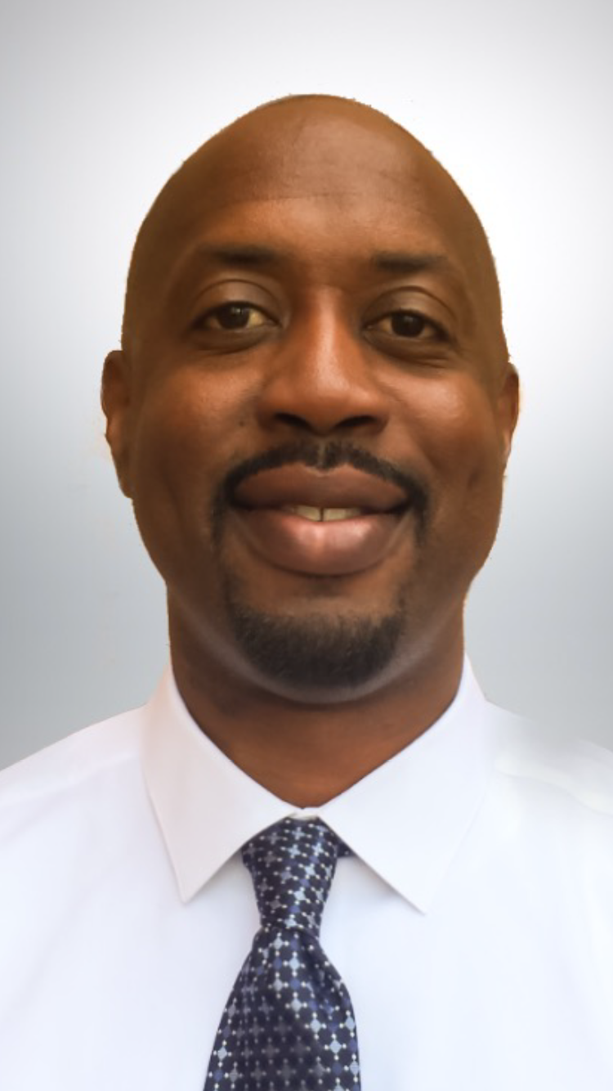
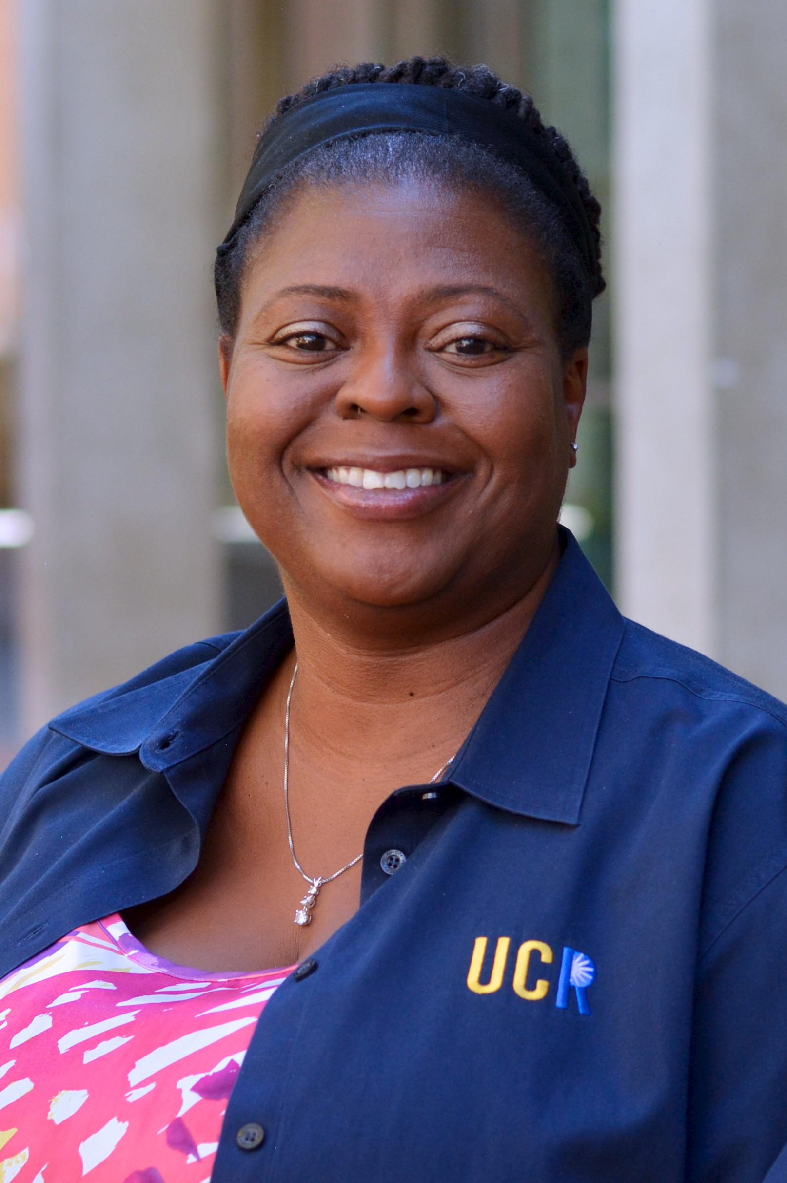
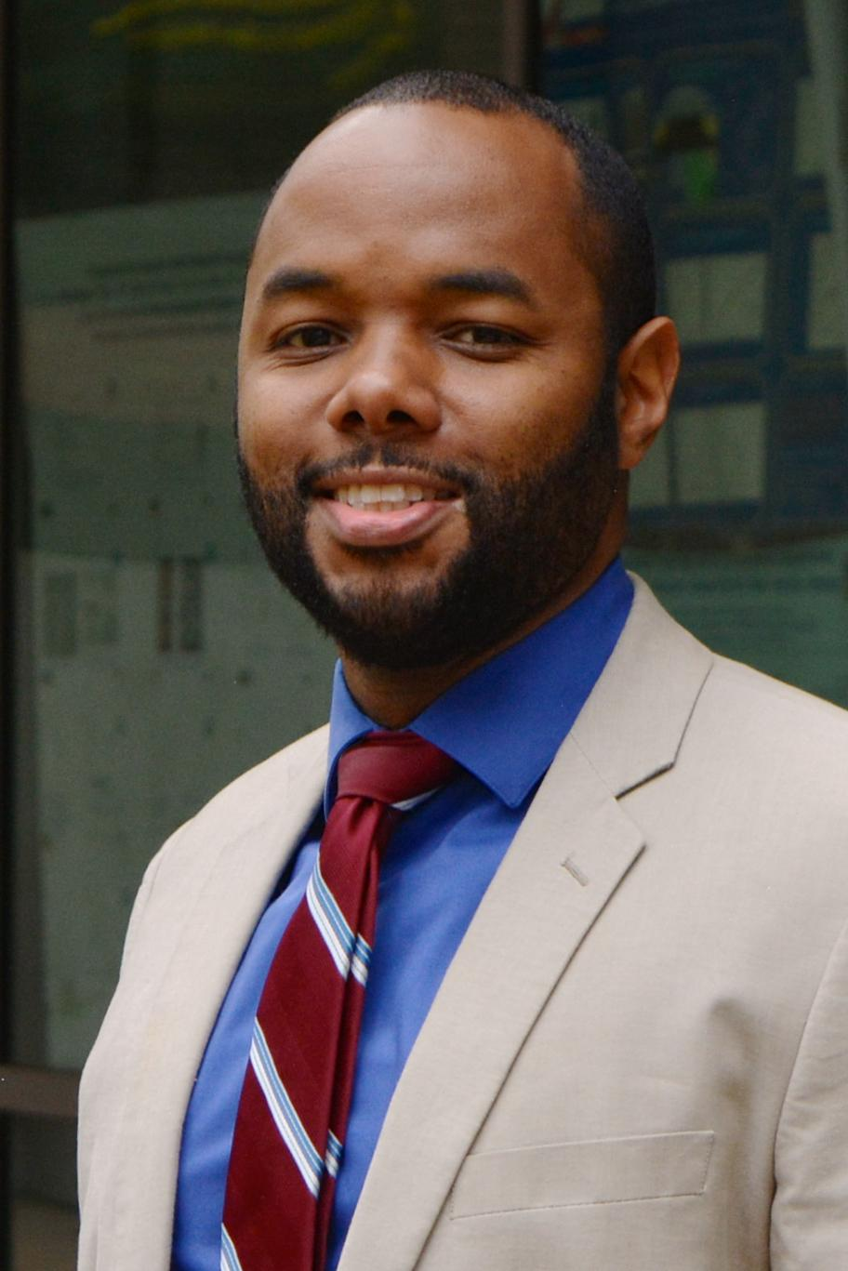
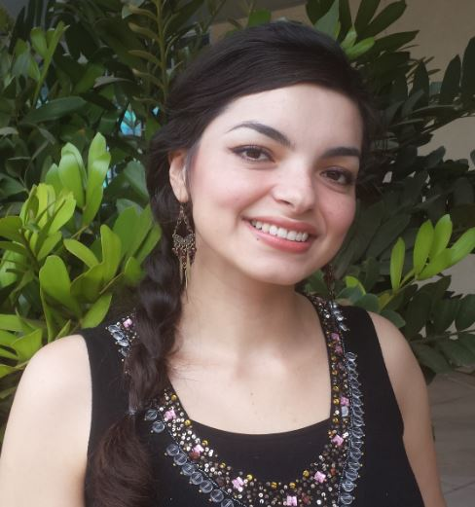
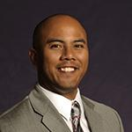
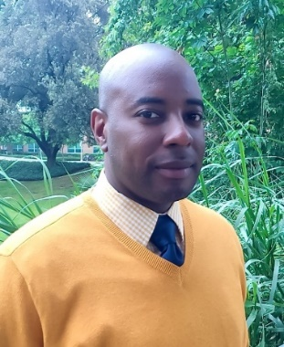
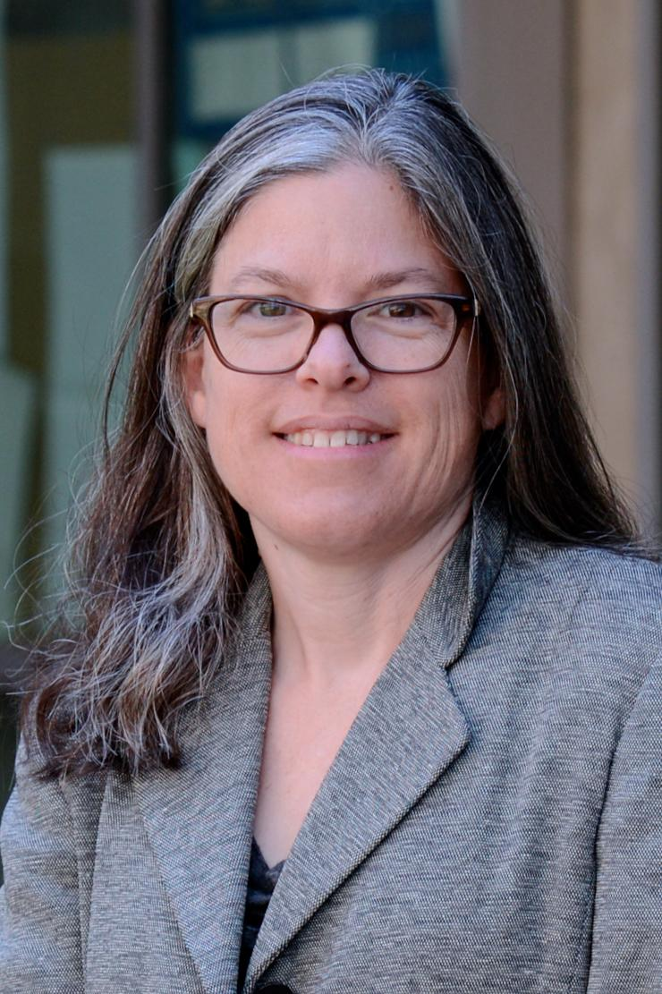
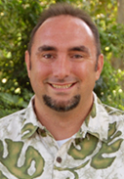
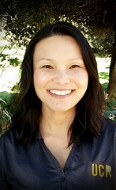
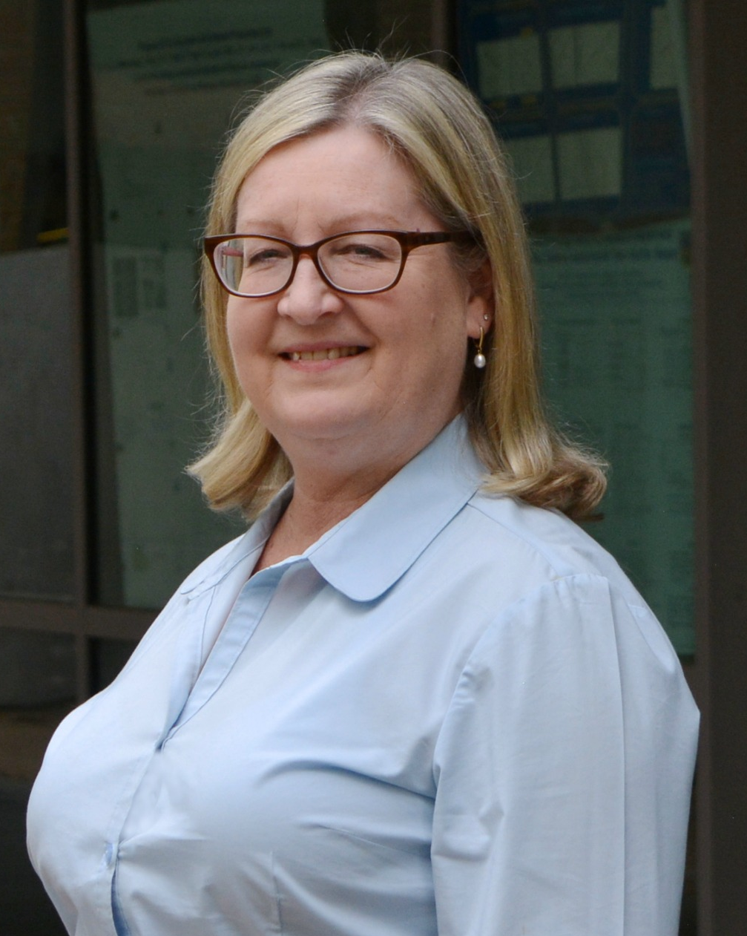
The Team – Academic Advisors
Roderick Smith
Director
Tara Brown
Assistant Director
Desmond Harvey
CHEN/ENEN
Janeth Jauregui
ENCS
Michael Cruz
ELEN
Malcolm Manuel
MCEN
Emily
Nudge
BIEN
Thomas McGraw
CEN/MSE
Terri
Phonharath
CSBA
Kim Wolf
Curriculum
Planner
Katelyn
Robinson
Advising/Enrollment

Slide 3
Short list of what we do ….
Advise and Mentor
We advise and mentor students on academic matters, support their success, academic and personal growth. We are generally the first line of contact regarding academic concerns.
Enforce Policy
Uphold academic policies of the university, BCOE, and its departments, explain policies, communicate options to students.

Slide 4
Things we do to support Departments and Faculty ….
..
Course Scheduling--Working with the Chairs, we develop the course schedule for all undergraduate programs.
Enrollment Management--We monitor enrollment ensuring compliance with policy; we manage concurrent enrollment, and all forms of adding and withdrawing from courses.

