Slide 1
SAFETY & FACILITIES

Slide 2
DEAN’S OFFICE SAFETY & FACILITIES
Maggie Souder
Director of Safety & Facilities
msouder@engr.ucr.edu
951-827-1241
Robert Lopez
Safety & Facilities Assistant
lopezra@engr.ucr.edu
951-827-1241

Slide 3
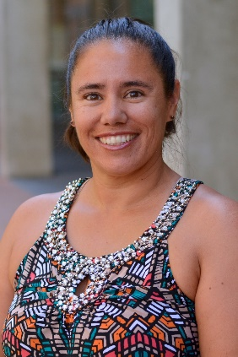
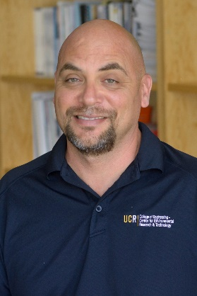
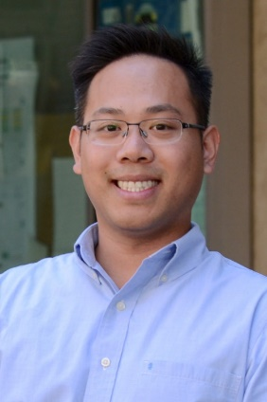
YOUR DEPARTMENT SAFETY PERSONS
Hong Xu
BIEN LSO
Kathy Cocker
CEE LSO
Todd Ambriz
CECERT LSO
Sara Galloway
CSE DSC
Manglai Zhou
ECE LSO
Perry Cheung
MSE LSO
Steve Rightnar
ME LSO
Mark Heiden
CNSE LSO

Slide 4
ONLINE RESOURCES
Supervisor responsibilities https://ehs.ucr.edu/laboratory/supervisorresponsibilities.html
BCOE Faculty Safety Resource page http://www.engr.ucr.edu/Intranet/facultysafetyresources.html
USE 951-827-5222 INSTEAD of 911
Steps in an emergency – https://ehs.ucr.edu/emergency/procedures/index.html
Reporting an injury – https://ehs.ucop.edu/efr/home
Environmental Health & Safety – http://ehs.ucr.edu
Find your LSO/DSC – http://www.engr.ucr.edu/Intranet/facultysafetyresources.html

Slide 5
THANK YOU

