Slide 1
We Engineer Excellence
Welcome!
Marko Princevac
Associate Dean for Student Academic Affairs
Professor of Mechanics Engineering

Slide 2
A few words on Research, Teaching and Service…
(what is there for you in each)

Slide 3
Our Students Impact Factor vs. Impact
Always keep in mind:
- you are a role model
- you are a mentor
- likely the first person with
advanced degrees that they interact
- you can make a difference in many lives

Slide 4
Undergraduate Research – Invaluable for student.
What is there for you?
At the very least:
- needed assistance in the lab
- possible verified graduate student
- publications, visibility

Slide 5
Undergraduate Research – Invaluable for student.
What is there for BCOE?
Our recruitment tool: freshmen, transfer GPP, international - what makes us different in their eyes.

Slide 6
Involvement
With university: Undergraduate Journal, Mini Grants, Undergraduate Research Symposium, major scholarship application preparation (Fulbright, Goldwater,…)
With community: RUSD Science Fair – (mentoring, judging, presenting), MS/HS Science Project Mentoring, MS/HS Teachers in the lab… - very valuable activities and connections for your grants

Slide 7
ABET
Nothing unreasonable
Quality control system: documenting, involving constituencies, making changes

Slide 8
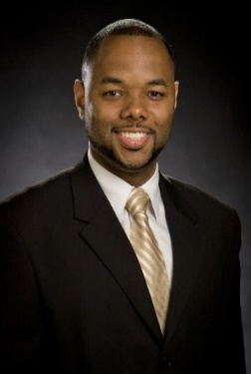
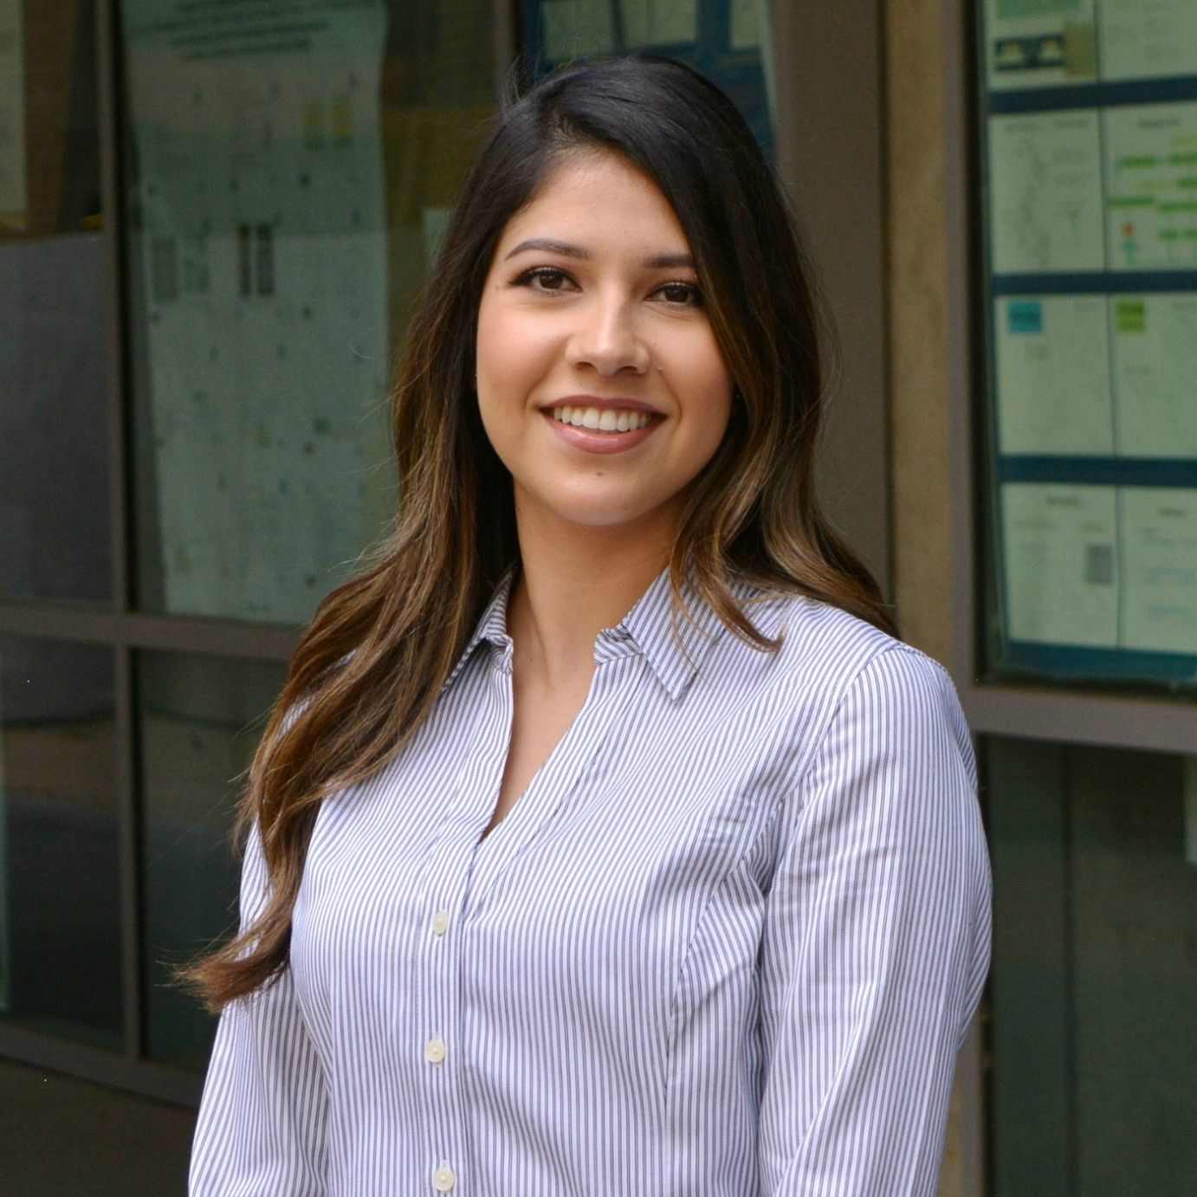
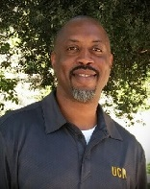
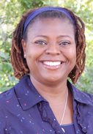
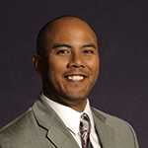
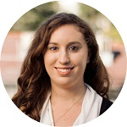
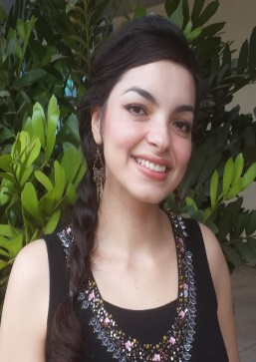
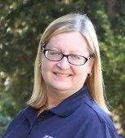
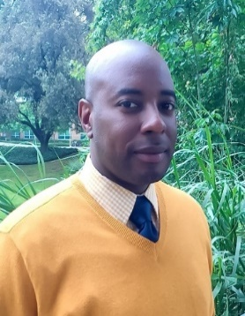
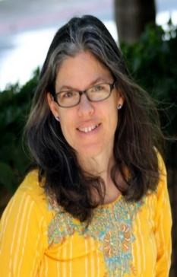
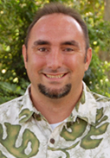
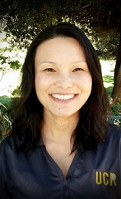
Your best friends – OSAA staff
The Office of Student Academic Affairs
http://student.engr.ucr.edu/
http://student.engr.ucr.edu/people/staffcontacts.html

Slide 9
OSAA Staff (http://student.engr.ucr.edu/people/staffcontacts.html)
Rod Smith
Director of OSAA
Change of Majors
Tara Brown
Assistant Director of OSAA
Readmission Petitions
Engineering Undeclared; Engineering Limited Student; Engineering Prep; Pre-Engineering
Kimberly Wolf
Scheduling
Katelyn Robinson
Enrollment
Thomas McGraw
Computer Engr and Material SE
Terri Phonharath
Computer Science with Business App
Malcolm Manuel
Mechanical
Emily Nudge
Bioengineering
Desmond Harvey
Chemical and Environmental
Janeth Jauregui
Computer Science
Michael Cruz
Electrical Engineering

Slide 10
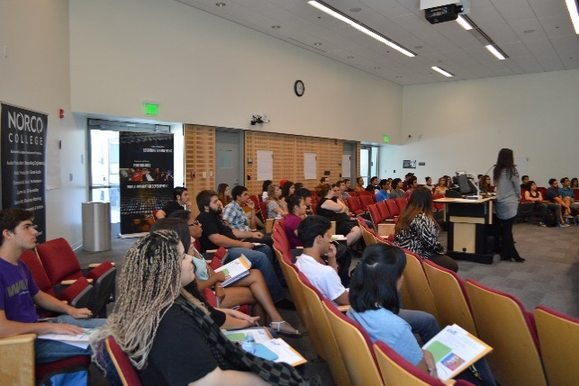
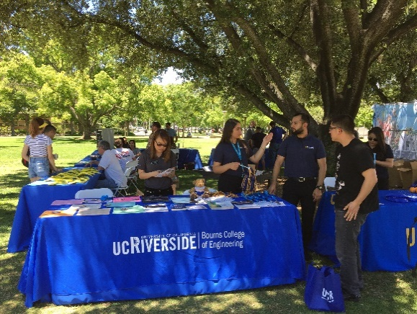
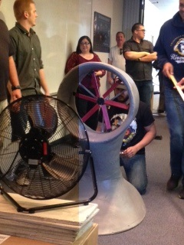
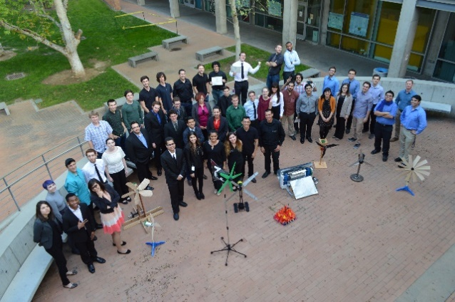
BCOE Transfer Initiatives
Community College Outreach
1-1 Advising, Workshops, Career & Job Fairs, Wind Turbine Competition with assistance from BCOE Peer Mentor, A Day in Life (CC students partnered BCOE students)
Guadalupe Ruiz

Slide 11
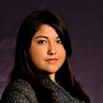
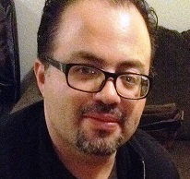
MESA Program
Our Outreach/Connection with Local Schools
Carlos Gonzales
Vanessa Guzman
Mission Statement (MESA California)
"MESA enables educationally disadvantaged students to prepare for and graduate from a four-year college or university with a math-based degree in areas such as engineering, the sciences, computer science, and mathematics…
…MESA has particular interest in and focus on students from those groups who historically have had the lowest levels of attainment to four-year and graduate level programs…
…MESA students and graduates will be better able to make significant contributions to the socioeconomic well-being of their families and their communities.”
Engaging and enriching STEM opportunities for our region’s underserved students…

Slide 12
Welcome to the Marlan and Rosemary Bourns College of Engineering!
We Engineer Excellence

