Slide 1
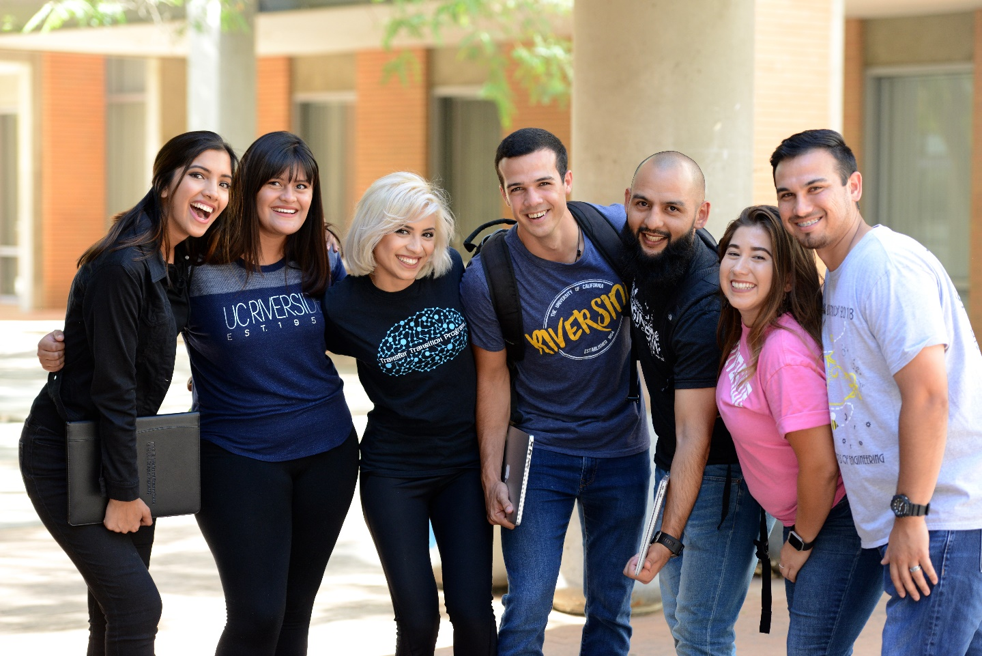
Student Success
Lupe Ruiz
Transfer Initiatives & Professional Development Coordinator

Slide 2
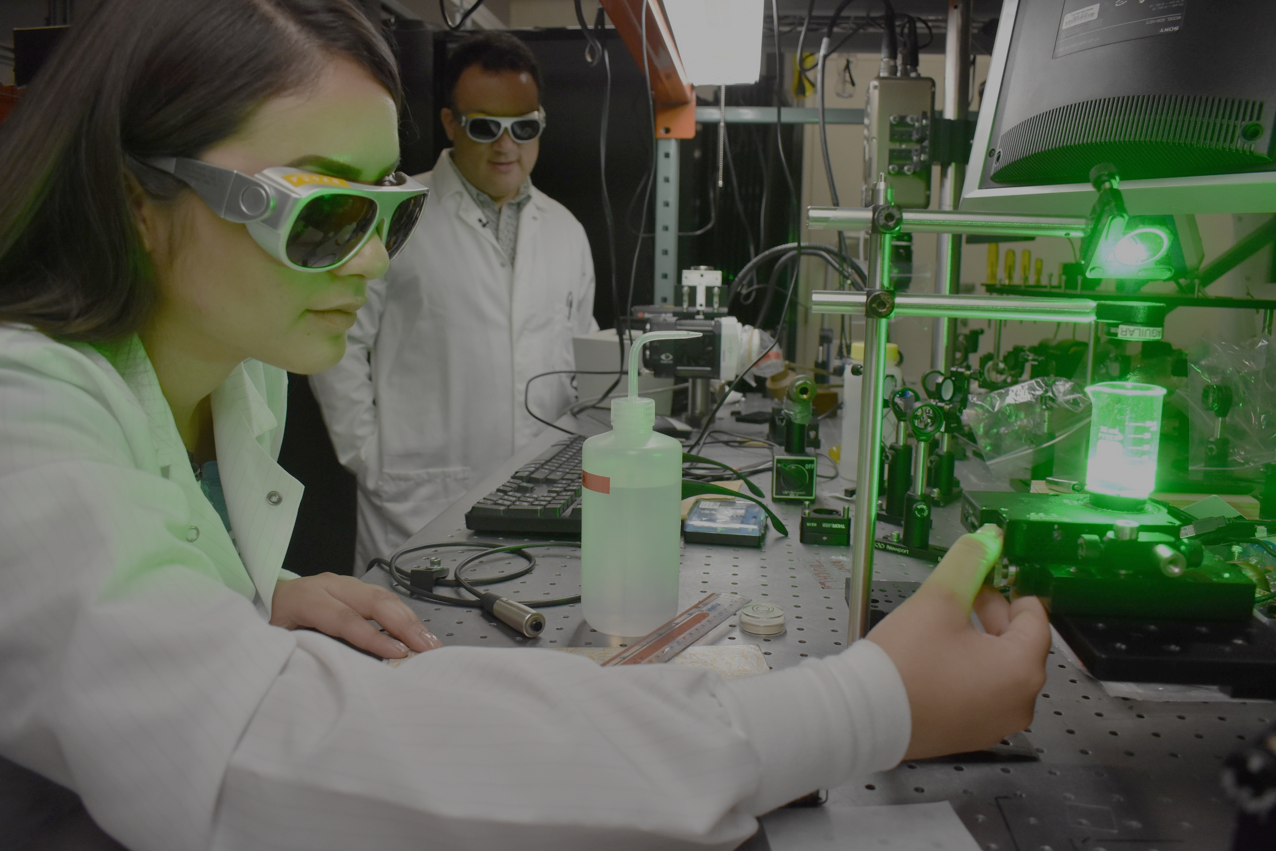
Professional Development
Student Professional Organizations
Transfer Initiatives/Support
Undergraduate Research

Slide 3
Undergraduate Researchers Volunteers Internships Full-time/part-time Guest Speaker Series BCOEStudentSuccess@engr.ucr.edu

Slide 4
Peer Mentors
Raymond Smith- Bioengineering
Tanish Arora- Computer Engineering
Jimena Hernandez- Electrical Engineering
Crysthal Alvarez- Mechanical Engineering
Anum Kazmi- Bioengineering
Kai Kawada- Computer Science
Norma Menjivar- Environmental Engineering
Brenda Lopez- Mechanical Engineering
Francisco Gallego- Computer Science
Yvette Salazar- Mechanical Engineering
Paul Carbajal- Mechanical Engineering

