Slide 1
eBuy UCR Purchasing System Requestor Instructions

Slide 2
eBuy Requestor Instructions
The following instructions will provide guidance for BCOE department Requestors on how to:
Access eBuy
Place non-eCatalog Orders
Place eCatalog Orders
Maintain Sub-Requestor Roles
View Requests and Search Submitted Orders

Slide 3
Featured Vendors
Please be aware that requests for the following featured vendors are processed through UCR ScotSupply due to better pricing and shipping discounts offered. They are not processed through eBuy. Please log into https://scotsupply.ucr.edu or work with your department Purchasing Assistant to complete your order for these vendors.
USA Scientific | Bio-Rad
Fisher Scientific | Gentec
IDT | Life Tec Thermo Fisher
New England Bio Labs | Airgas
Qiagen | Sigma Aldrich

Slide 4
Accessing eBuy
The eBuy UCR Purchasing System is located within the R’Space portal where all campus applications are housed.
The URL for the R’Space portal is https://rspace.ucr.edu.
You will need to use your UCR NetID and Password to log in.
Please note - your UCR NetID/Password are generated through the Enterprise Directory and are separate from your Engineering account Username/Password.

Slide 5
Accessing eBuy cont.
Prior to accessing eBuy all users are required to complete mandatory Purchasing training through the UC Learning Center (LMS), which is also located in R’Space.
Once you have completed the training your department FAO/MSO will assign your role in eBuy. After your role has been assigned and you have successfully logged into the R’Space portal you can search for eBuy by clicking on the Authorized Apps tab located under the R’Space logo.

Slide 6
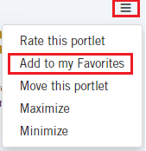
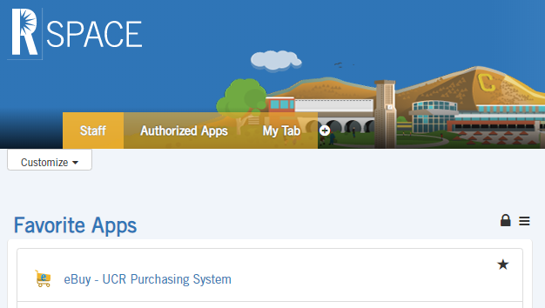
Accessing eBuy cont.
The eBuy application icon looks like a shopping cart with the letter “e” on its side. Clicking on the 3 horizontal lines above the icon will open a menu where you can select to “Add to my Favorites.” By adding the app to your favorites, the app icon will populate in your Favorite Apps list on your R’Space portal main page where you will be able to easily access the app each time you log in without having to search for it.

Slide 7
Non-eCatalog Orders
Upon clicking the eBuy app icon a new tab will open in your web browser with the eBuy application.
To initiate a request click “Create Request” under the Requestor Options.
If a student has been assigned the Sub-Requestor role they can initiate a request by clicking “Create Request” under the Sub-Requestor Options.
Requestors can create a request and submit it directly to the Purchasing Assistant for processing.
Alternatively, a Sub-Requestor (student) can create the request and send it to the Requestor (PI) for review and approval.

Slide 8
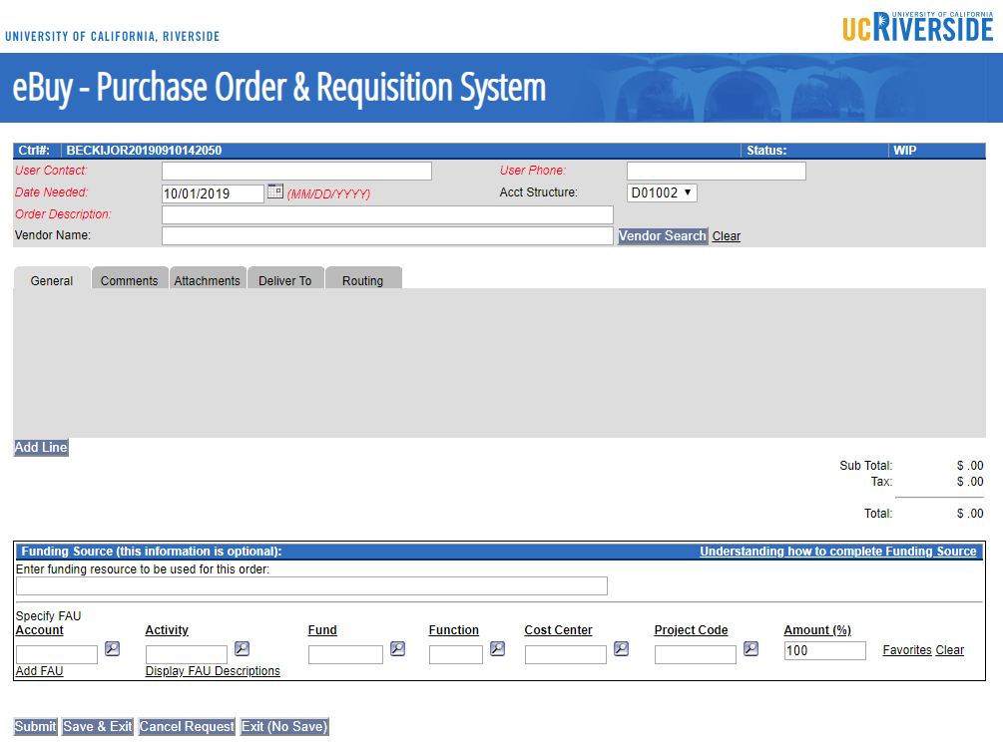
Non-eCatalog Orders cont.
All fields in red must be completed. To ensure your order is placed with the correct vendor please complete the Vendor Name field by either using the “Vendor Search” button or by manually typing in the vendor name.
Click the “Add Line” button to open a pop up window will appear where you will need to enter the relevant information for the item(s) you need to order.
Begin by completing the required red italic fields. You must also include the vendor name. You can either use the Vendor Search button or enter the vendor name manually.
Click the “Add Line” button to enter needed items (a pop-up window will appear).

Slide 9
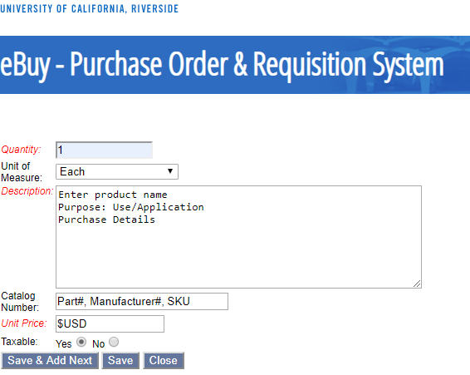
Non-eCatalog Orders cont.
In the pop up window please complete all fields for the item(s) you need to order. If you need to order multiple separate items, you can click the “Save & Add Next” button to add another line on your purchase order.
Enter your order information here. Red italics indicate a required field.
If you have the item SKU, Part or Manufacturer number please enter that information.
Please add the unit price per item.
Generally all good(s) are taxable; research good(s) may be permitted to reduced sales tax terms if applicable.
You can then either “Save” or “Save & Add Next” if you have multiple lines of items to enter.

Slide 10
Non-eCatalog Orders cont.
When you have completed filling in the order form click the “Submit” button and the order will be sent directly to the Purchasing Assistant. The assistant will review the information, place the order and request a confirmation from the vendor.
The steps are the same for Sub-Requestors except their order goes to the PI once submitted. An email is sent to notify the (PI). Once the PI reviews the order and indicates a funding source, he/she then clicks the submit button and the order is sent directly to the Purchasing Assistant.
You can include attachments as needed, such as quotes and approvals.
You can also leave comments for special handling, urgency, etc.
Requestors MUST indicate the funding source to be charged (IC, NSF, Academic Senate, etc.) otherwise the Purchasing Asst. cannot proceed with the order and there will be a delay in processing.
You DO NOT need to list the specific FAU. The Purchasing Asst. will fill this in based on the funding source description you provide.
Click the “Submit” button once you are ready to send the order to the Purchasing Asst.

Slide 11
eCatalog Orders
To initiate an eCatalog request click “Create eCatalog” Request under the Requestor Options.
A Sub-Requestor can also initiate an eCatalog request by clicking “Create eCatalog” under the Sub-Requestor Options.
eCatalog has a list of vendors who have an agreement with the University. Shopping through eCatalog is similar to shopping on other on-line sites such as Amazon.com.

Slide 12
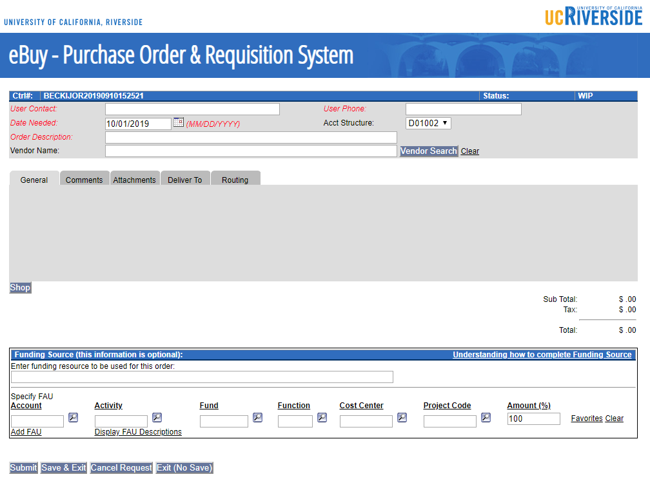
eCatalog Orders cont.
All fields in red must be completed before you can shop in the catalog. Once you have completed the required fields click the “Shop” button to launch the eCatalog within the same web browser tab.
Begin by completing the required red italic fields.
Click the “Shop” button to launch the eCatalog.

Slide 13
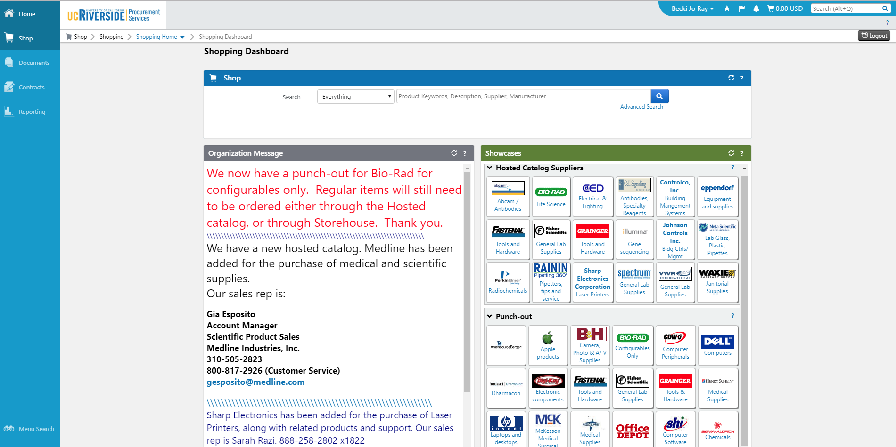
eCatalog Orders cont.
Vendors listed in the “Hosted Catalog Suppliers” menu require you to know the item or part number that you are searching for.
Vendors listed in the “Punch-Out” menu have direct links to their website with UCR pricing. You can simply browse and add items to the cart as needed. Once you click “checkout” the cart information is automatically populated in eBuy. Items ordered via the Punch Out section are automatically sent to the vendor.
Vendors in this menu require you to know the item or part number you want to order.
Vendors in this menu have direct links to their website with UCR pricing.

Slide 14
Adding Sub-Requestor Roles
Only the Requestor can assign Sub-Requestor roles. The Sub-Requestor must complete the mandatory Purchasing training through the UC Learning Center (LMS) and have a NetID in order to be granted access.
Click “Maintain Sub-Requestors.”

Slide 15
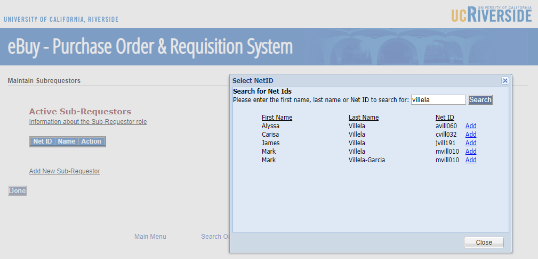
Adding Sub-Requestor Roles cont.
You can enter multiple Sub-Requestors as long as they have:
completed the required training
a NetID
purchasing authority for your lab
First, click the “Add New Sub-Requestor” link. A pop up box will appear.
Enter the last name in the search field, then “Add” the appropriate person from the list.

Slide 16
Viewing Requests & Searching Orders
Requestors can View Requests (WIP) or Search Orders from within the Requestor Options section on the eBuy main menu.
Click “View Requests” to view those that are a Work in Progress (WIP). Note that a zero (0) indicates there are no requests pending.
Click “Search Orders” to view those that have been submitted by your department Purchasing Assistant.

Slide 17
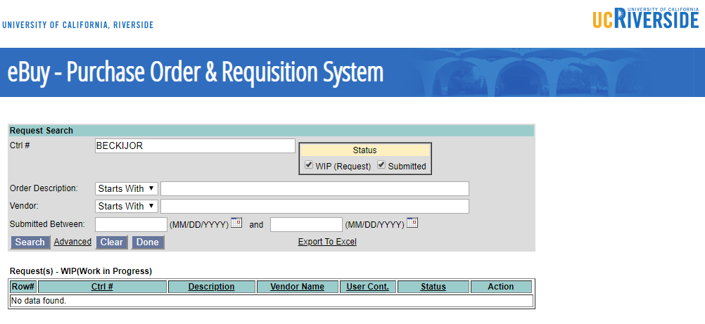
View Requests
View Requests (WIP) are orders submitted by Sub-Requestors or orders that you have saved, but have not submitted to your department Purchasing Assistant.

Slide 18
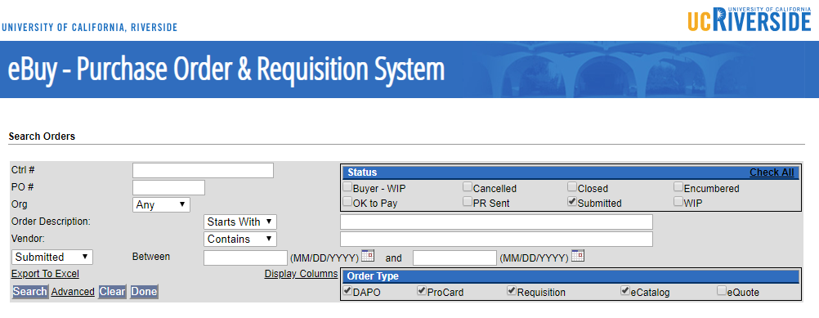
Search Orders
Search Orders gives you the ability to search your previous orders, your Sub-Requestor’s orders, or other orders in your department.
Use any one or all of the available fields to help narrow the search for your orders.
Click “Check All” in the Status section to include all options available.

Slide 19
Additional Assistance
If you require additional assistance or have questions, please contact your departmental Purchasing Assistant.
Bioengineering Angela Cherry (951) 827-4303 angela.cherry@ucr.edu | Chemical and Environmental Engineering Deanna Vorhees (951) 827-2423 deanna.vorhees@ucr.edu
Computer Science and Environmental Engineering Sara Galloway (951) 827-2401 sara.galloway@ucr.edu | Electrical and Computer Engineering Jessica Duarte (951) 827-2254 jessica.duarte@ucr.edu
Materials Science and Engineering Christina Gnuschke (951) 827-3392 christina.gnuschke@ucr.edu | Mechanical Engineering Juana Guerrero (951) 827-2414 juana.guerrero@ucr.edu

