Slide 1
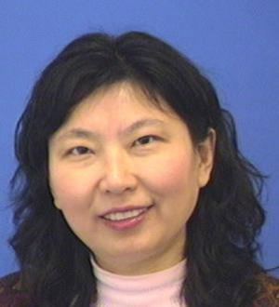
Librarians
Ying Shen: Library Class Sessions
Michele Potter: Purchasing Suggestions
Kat Koziar: Data Management (Plans, Sharing, etc)

Slide 2
10 Library Services
Research Assistance
Citation Management
ORCID
VPN
ILL (Interlibrary Loans)
Databases
WOS
Reserves
Open Access Mandate
Different than eFile
Creat’R Lab
3d Printing
Data Services
LibGuide http://guides.lib.ucr.edu/engfac

