Slide 1
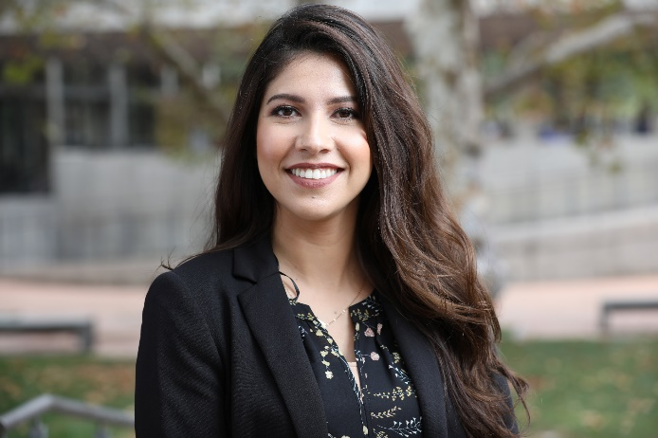
ENGINEERING CAREER DEVELOPMENT
Resume & Interview Skill Workshops
Career Info Session featuring Engineering Companies
Job Searching Techniques Workshop
Guest Speakers Panel
Visits & Tours at Engineering Companies
Graduate & Professional School Info Sessions
FE/EIT/PE Training & Info Sessions
STEM & Engineering/ Technical Career Fairs
And More!
Guadalupe Ruiz
Professional Development Coordinator
Seeking undergraduate researchers? Email: gruiz@engr.ucr.edu

Slide 2
PROFESSIONAL STUDENT ORGANIZATIONS
23 Student Professional Organizations
1200+ Student Members
50%
Student Participation
Majors/Honors
Project Based
Cultural Diversity
Notes:
BCOE student orgs are extremely active with 50% participation. Benefits: Leadership, communication, collaboration, innovation, networking

Slide 3
Our students are hosting…
Start Hacking!
Cutie Hack
Citrus Hack
Rose Hack
Bio Hack
Next Generation of Engineers
Engineering R’ Future
Dia de Ciencias
Bourns Engineering Day
IEEE Merit Badge Day
Professional Development
Professional Development Fair
Power Brunch
Research Networking Night
Workshops with Alumni & Industry Experts
Conferences

Slide 4
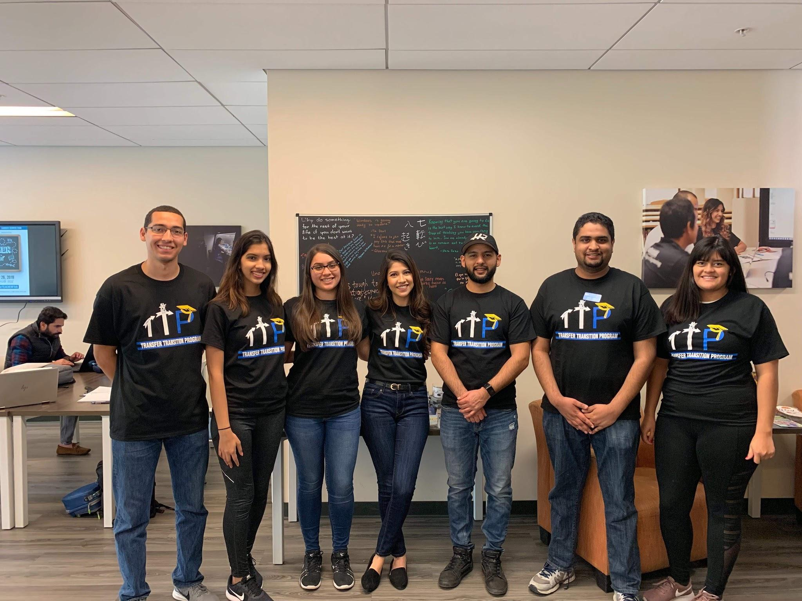
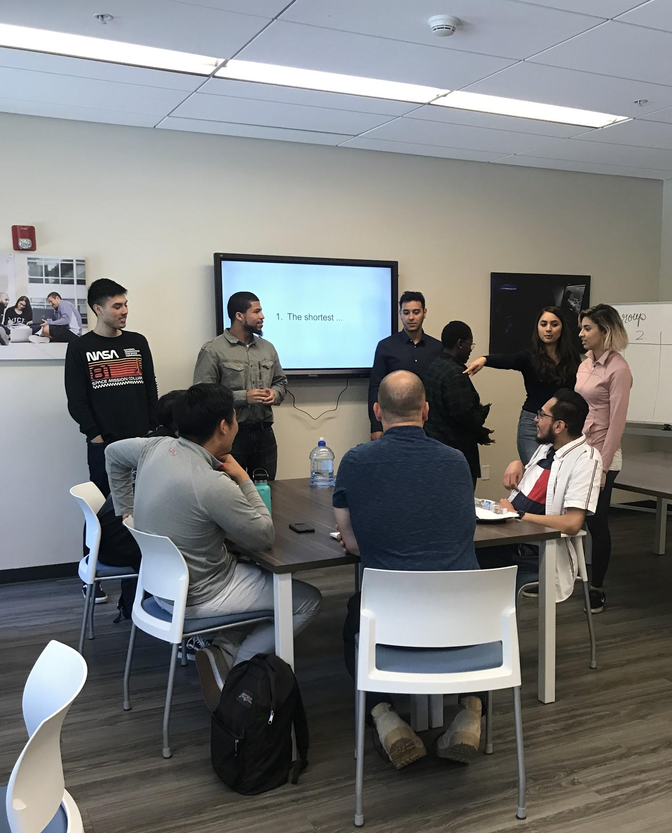
Transfer Center
Home to all engineering transfer students!
Study
Socials
Study jams
Workshops
Networking
In WCH 103

