Slide 1
Financial and Business Operations

Slide 2
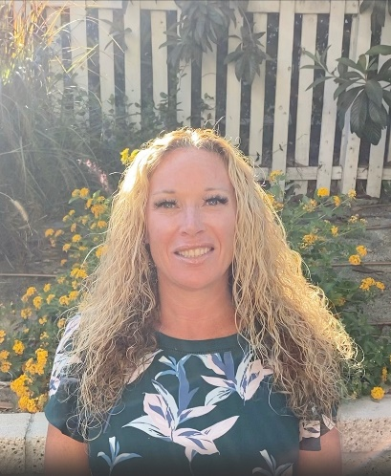
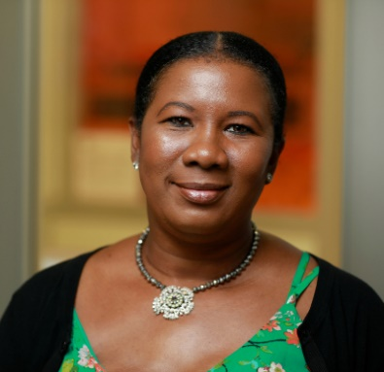
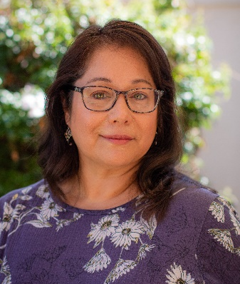
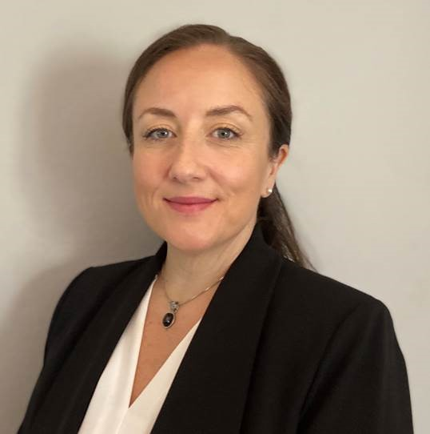
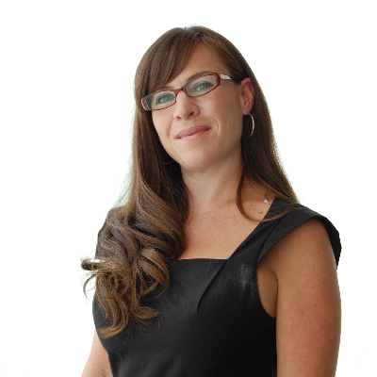
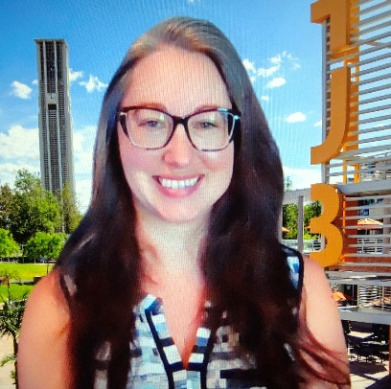
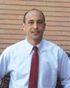
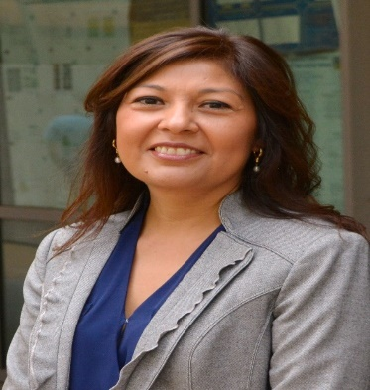
Departmental Financial and Administrative Officers
Dean’s Office
Bioengineering
Chemical/Environmental Engineering
Computer Science and Engineering
Alissa Rackstraw
Interim Assistant Dean, Finance and Administration
Nadine Okuns
Kathrine Fruge
Grace Caslavka
Electrical and Computer Engineering
Materials Science & Engineering
Mechanical Engineering
Katie Meumann
Interim Director, Financial and Business Operations
Nicole Kramer
Christina Gnuschke
Bill Bingham

Slide 3
Finance and Administration
Financial and Budgetary Support
Post Award Administration
Purchasing/Procurement
Faculty Reimbursements
Travel Administration
Payroll/Personnel Actions
Rspace Portal https://auth.ucr.edu/cas/login?service=https://portal.ucr.edu/uPortal/Login
Financial & Administrative Applications – Travel, eCAF, UCPath Portal, etc.

Slide 4
Quick Reminders
Initial Complement Funds/ Start-Up Package
Managed by Dean’s Office
6 years to spend
Regular reporting (review and approve)
Internal Allocation Accounts
Managed by Dean’s Office
Established once you have faculty designated funds
Academic Year Faculty Salary Savings Allocations
Funds for BCOE Appointments including Chairs and Associate Deans
Allocations for Indirect Cost for Indirect Cost Return
Allocations for MSOL Incentives
Financial and Business Processes (Travel, Purchasing Reimbursements etc. )
Managed at the department level
Schedule time to meet with Financial and Administrative Officer to understand UCR policies and procedures.
Post Award Administration
Managed at the department level
Schedule time to meet with Contract and Grant Analyst to understand the process.
For complex or escalated issues contact Katie Meumann in the Dean’s Office

Slide 5
Suggestions to consider
Meet with your departmental staff to become familiar with UCR policies and procedures.
Don’t hesitate to ask questions or raise concerns.
Be proactive with the administration of your financial resources.
Plan ahead and solicit support when needed.
Dean’s Office Financial Staff Contact Information
Alissa Rackstraw
(951)827-6417
Alissa.Rackstraw@ucr.edu
Katie Meumann
(951)827-2995
Katie.Meumann@ucr.edu
Questions

